Slide 1
Distributed System
(BESE-VII)
POKHARA UNIVERSITY
Compiled by
Er. Madan Kadariya
Assistant Professor
HOD, Department of Information Technology Engineering
Nepal College of Information Technology
Balkumari, Lalitpur

Slide 2
Chapter 2: Replication and Fault Tolerance
  References:
  G. Coulouris, J. Dollimore and T. Kindberg; Distributed Systems Concepts and Design,4th Edition.
  Andrew S. Tanenbaum and Maarten van Steen; Distributed Systems: Principles and Paradigms, 2nd Edition.
Distributed System (DS)

Slide 3
Replication and Fault Tolerance
5.1. Reasons for replication
5.2. Object replication
5.3. Replication as scaling techniques
5.4. Fault Tolerance Services: Active & Passive Replication
5.5. Failure masking by redundancy
5.6. Agreement in faulty system
5.7. Reliable client server communication
5.8. Distributed commit
5.9. Recovery Approaches

Slide 4
Reasons for Replication
Data replication is a common technique in distributed systems. There are two reasons for data replication:
  It increases the reliability of a system.
    If one replica is unavailable or crashes, use another
    Protect against corrupted data
  It improves the performance of a system.
    Scale with size of the distributed system (replicated Web servers)
    Scale in geographically distributed systems (Web proxies)
The key issue is the need to maintain consistency of replicated data.
  If one copy is modified, others become inconsistent.
Distributed System (DS)

Slide 5
Object Replication
There are two approaches for object sharing:
  The object itself can handle concurrent invocation.
    A Java object can be constructed as a monitor by declaring the object’s methods to be synchronized.
  The object is completely unprotected against concurrent invocations, but the server in which the object resides is made responsible for concurrency control.
    In particular, use an appropriate object adapter.
Distributed System (DS)

Slide 6
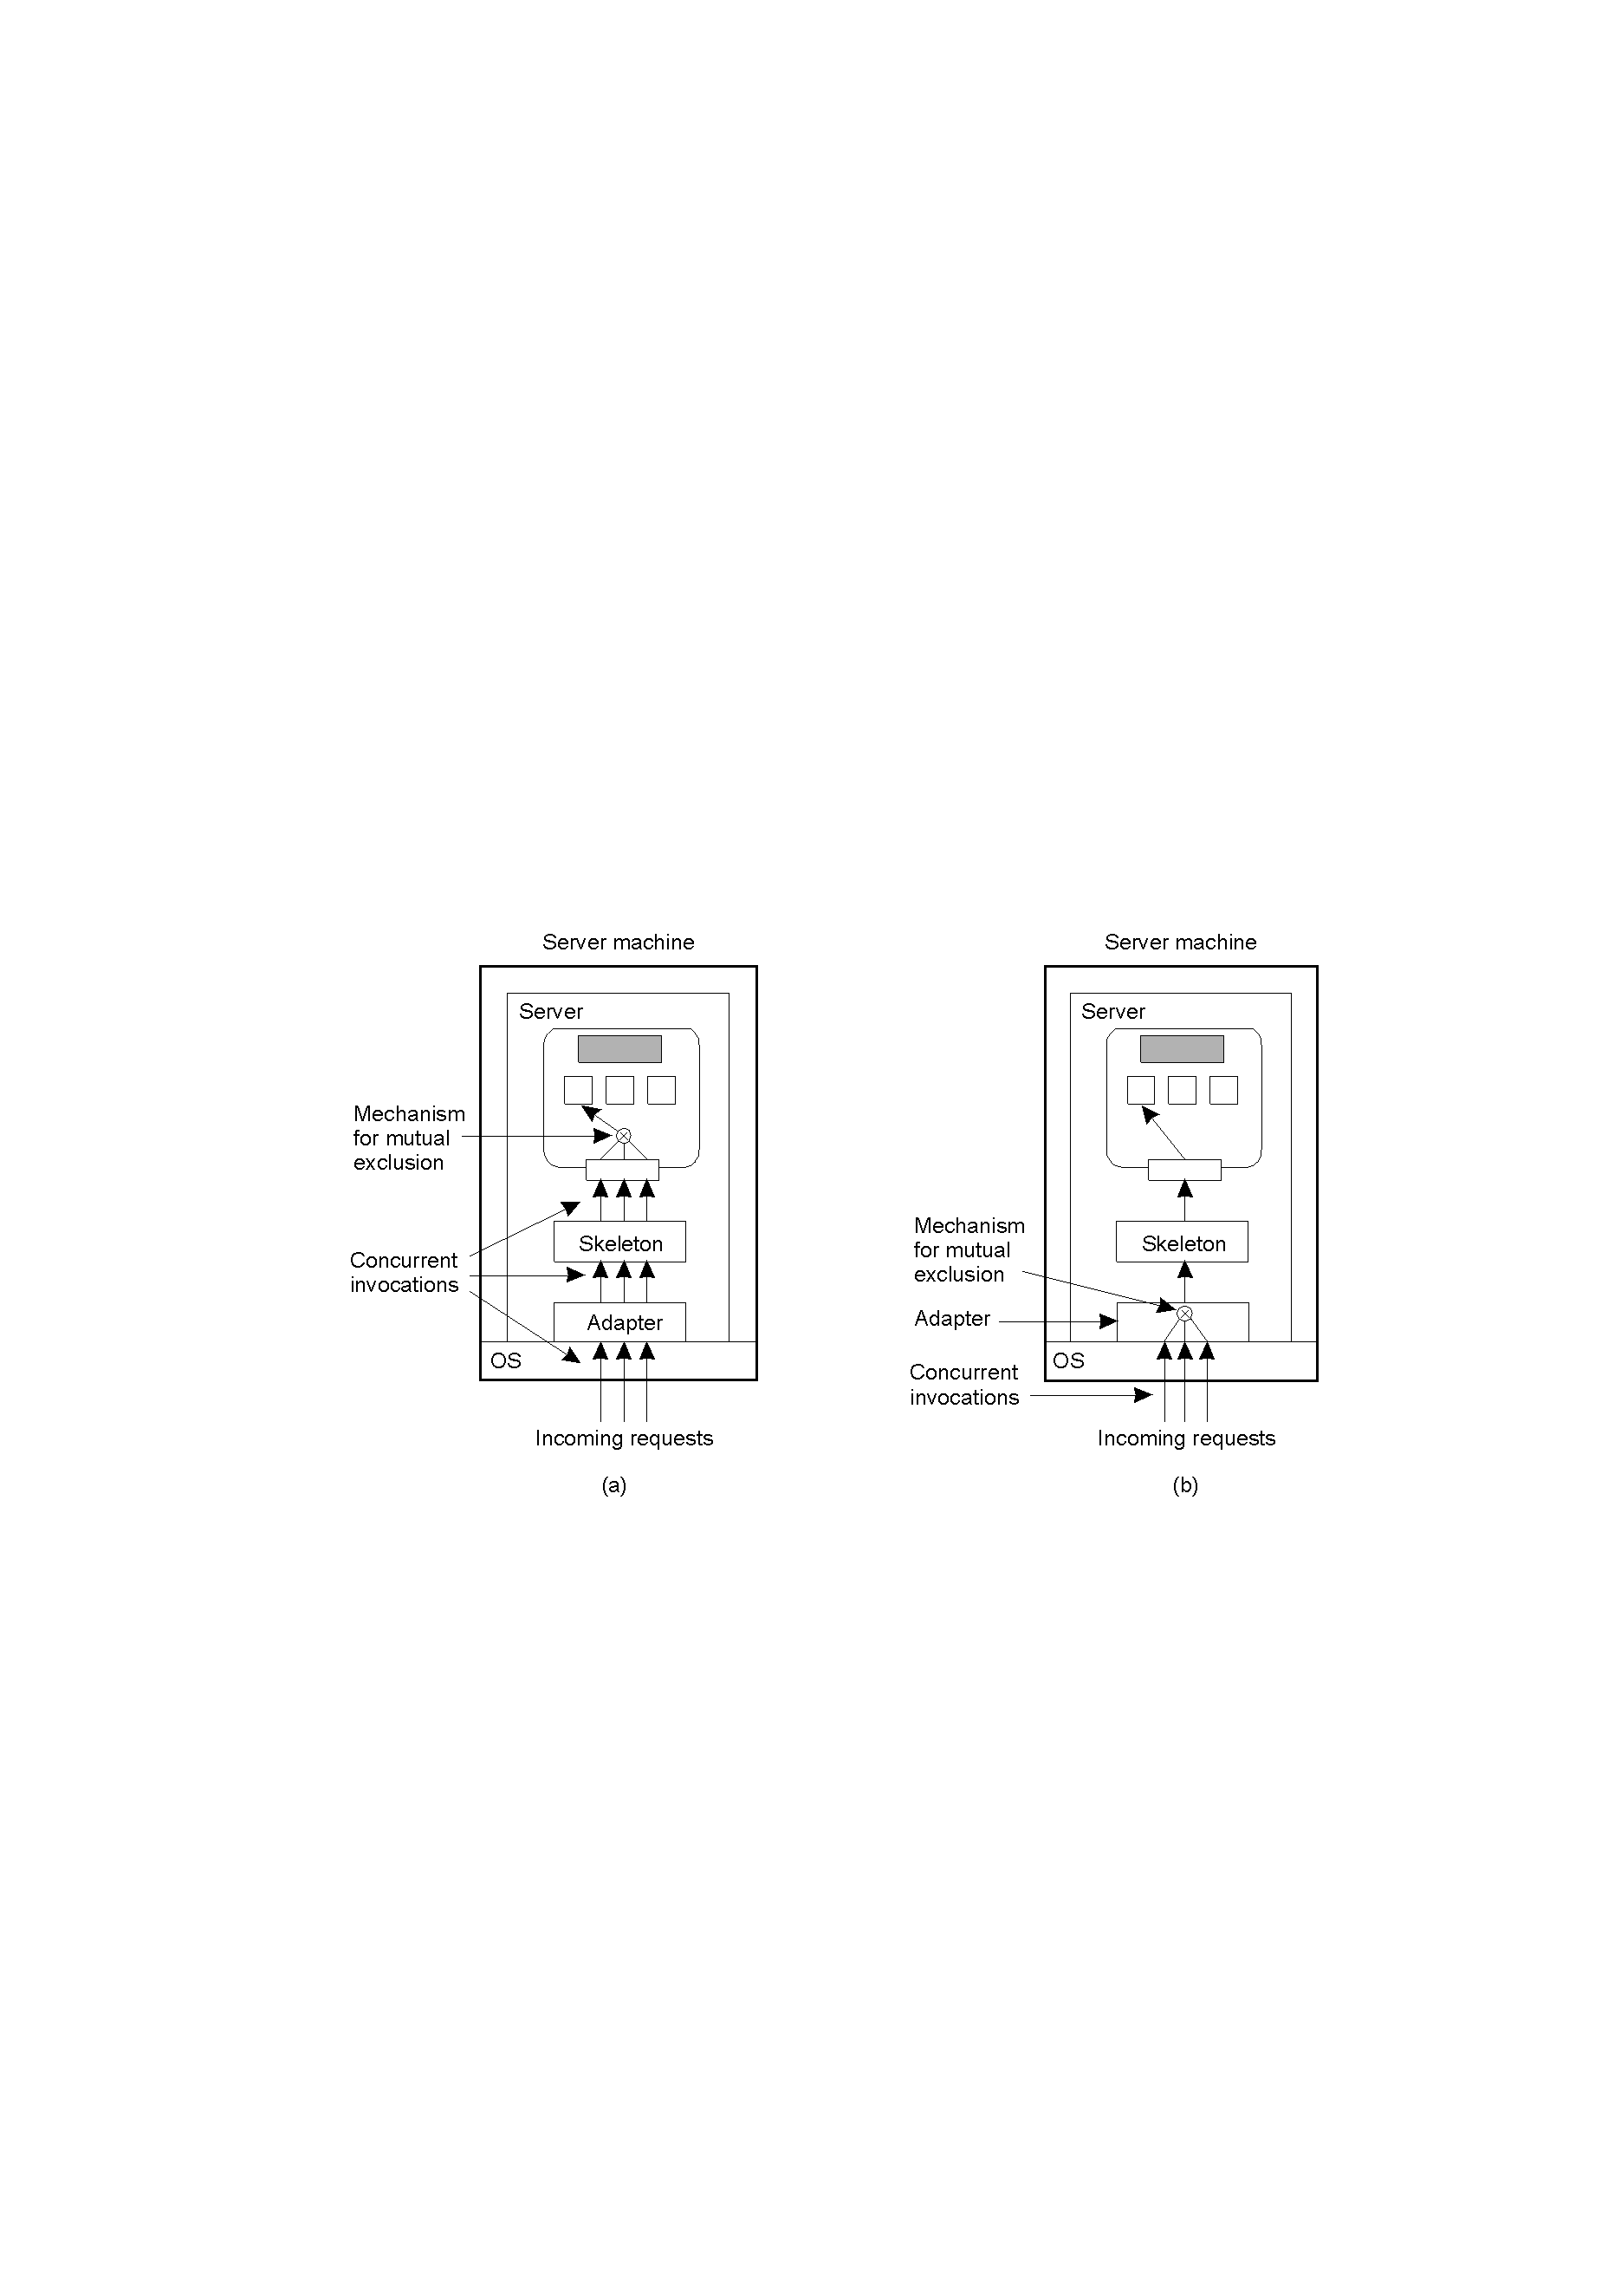
Object Replication
A remote object capable of handling concurrent invocations on its own.
A remote object for which an object adapter is required to handle concurrent invocations
Distributed System (DS)

Slide 7
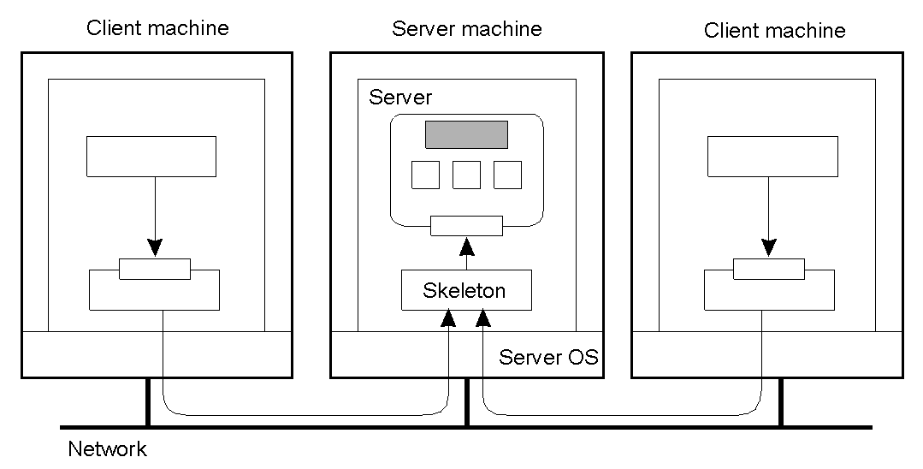
Object Replication
Organization of a distributed remote object shared by two different clients.
Distributed System (DS)

Slide 8
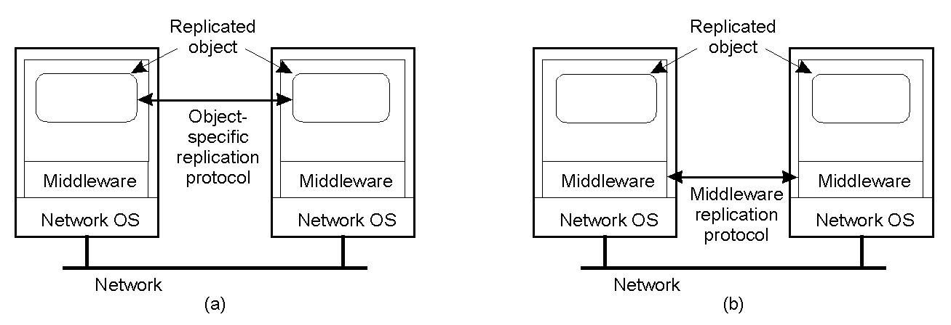
Object Replication
There are two approaches for object replication:
  The application is responsible for replication (Fig (a)).
    Application needs to handle consistency issues.
  The system (middleware) handles replication (Fig(b)).
    Consistency issues are handled by the middleware.
    It simplifies application development but makes object-specific solutions harder.
Distributed System (DS)

Slide 9
Replication and Scaling
Replication and caching are used for system scalability.
Multiple copies improve performance by reducing access latency but have higher network overheads of maintaining consistency.
  Example: An object is replicated N times.
    Consider the Read frequency R and the write frequency W
    If R << W, high consistency overhead and wasted messages
    Consistency maintenance is itself an issue
      What semantics to provide?
      Tight consistency requires globally synchronized clocks.
Distributed System (DS)

Slide 10
Replication and Scaling
The solution is to loosen consistency requirements.
  Variety of consistency semantics possible
Consistency model (consistency semantics)
  Contract between processes and the data store
    If processes obey certain rules, data store will work correctly.
  All models attempt to return the results of the last write for a read operation.
    Differ in how last write is determined/defined
Distributed System (DS)

Slide 11
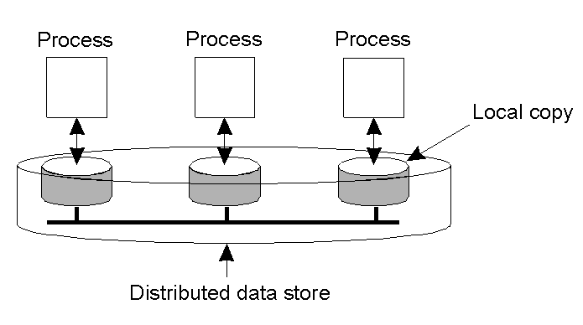
Data-Centric Consistency Models
The general organization of a logical data store, physically distributed and replicated across multiple processes.
Distributed System (DS)

Slide 12
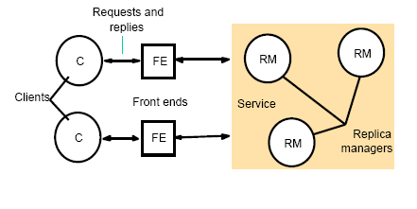
System Model
Assume
  Replica Manager applies operations to its replica
  set of replica managers may be fixed or could change dynamically
  requests are reads or writes (updates)
A basic architectural model for the management of replicated data
Distributed System (DS)

Slide 13
System Model-Replica manager
Five phases in performing a request
  Front end issues the request
      Either sends to a single (primary) replica or multicasts to all replica managers
  Coordination
      RMs coordinate in preparation for the execution of the request, i.e., agree if request is to be performed and the ordering of the request relative to others
      FIFO ordering, Causal ordering, Total (sequential) ordering
  Execution
      May be tentative (not fully agreed upon).
  Agreement
      Reach consensus on effect of the request, e.g., agree to commit or abort in a transactional system
  Response: One or more RMs pass a response back to the front end.
Distributed System (DS)

Slide 14
Replication technique for fault tolerance (service provision technique)
Passive Replication
Active Replication
Both the technique provide the fault tolerance. In passive replication there is only one server (called primary) that processes client requests. In active replication each client request is processed by all the replicas
Distributed System (DS)

Slide 15
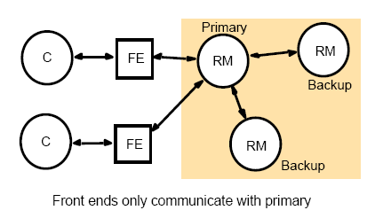
The Passive (Primary-Backup) Model
PRM( Primary Replica Manager) informs to all BRM(Backup Replica Manager) and provides the updated data BRM.
Only Primary Replica manager is directly connected to front end
Distributed System (DS)

Slide 16
Passive (Primary-Backup) Replication
Request: Front end issue client request with unique request ID to PRM(primary replica manager).
Coordination: primary RM takes updates in FIFO. It is just preparation for execution. It maintains the order of request for execution. It may maintains the request in FIFO, causal and total ordering etc.
Execution: primary RM executes the update and stores the response
Agreement: primary sends the update to all backups. The backups send acknowledgements
Response: primary responds to the FE, which hands the response back to the client
If primary fails,
  It should be replaced with a unique backup
  RMs that survive must agree upon which operations had been performed when the replacement primary takes over.
Distributed System (DS)

Slide 17
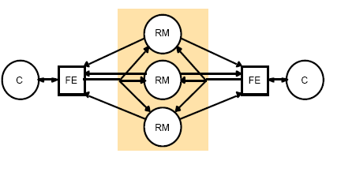
Active Replication Using Multicast
Active replication
  FE multicasts request to each replica
Distributed System (DS)

Slide 18
Active Replication Using Multicast
Sequence of Events:
Request: FE with unique identifier of client request multicast request to all RM in a totally order fashion.
Co-ordination: The Group command system deliver request to every RM in same(total) order.
Execution: Every RM execute request which are delivered in same (total-> if a process issue m then m’ then m->m’ ) order, correct RM process the request identically. Since the request is send in same order.
Agreement: This phase not required, every RM process request separately.
Response: Each RM send response to FE the no of replicas that the front end collects depends up on failure assumption and on the multicast algorithm. If , for example, the goal is to tolerate only crash failure and the multicast satisfies uniform agreement and ordering properties, then the FE passes first response to client discarding others response.
If request = n then ,
Response is <= n.
Drawbacks: Unnecessary response flow.
Distributed System (DS)

Slide 19
Fault Tolerance
Part I Introduction
Part II Process Resilience
Part III Reliable Communication
Part IV Distributed Commit
Part V Recovery

Slide 20
Faults
A system fails when it cannot meet its promises (specifications)
An error is part of a system state that may lead to a failure
A fault is the cause of the error
Fault-Tolerance: the system can provide services even in the presence of faults
Faults can be:
  Transient (appear once and disappear)
  Intermittent (appear-disappear-reappear behavior)
    A loose contact on a connector ➔intermittent fault
  Permanent (appear and persist until repaired)
Distributed System (DS)

Slide 21
Fault Tolerance
A DS should be fault-tolerant
  Should be able to continue functioning in the presence of faults
Fault tolerance is related to dependability
Dependability Includes
  Availability
  Reliability
  Safety
  Maintainability
Distributed System (DS)

Slide 22
Availability & Reliability (1)
Availability: A measurement of whether a system is ready to be used immediately
  System is available at any given moment
Reliability: A measurement of whether a system can run continuously without failure
  System continues to function for a long period of time
A system goes down 1ms/hr has an availability of more than 99.99%, but is unreliable
A system that never crashes but is shut down for a week once every year is 100% reliable but only 98% available
Distributed System (DS)

Slide 23
Safety & Maintainability
Safety: A measurement of how safe failures are
  System fails, nothing serious happens
  For instance, high degree of safety is required for systems controlling nuclear power plants
Maintainability: A measurement of how easy it is to repair a system
  A highly maintainable system may also show a high degree of availability
  Failures can be detected and repaired automatically? Self-healing systems?
Distributed System (DS)

Slide 24
System reliability: Fault-Intolerance vs. Fault-Tolerance
The fault intolerance (or fault-avoidance) approach improves system reliability by removing the source of failures (i.e., hardware and software faults) before normal operation begins
The approach of fault-tolerance expect faults to be present during system operation, but employs design techniques which insure the continued correct execution of the computing process
Distributed System (DS)

Slide 25
Failure Models
Type of failure | Description
Crash failure | A server halts, but is working correctly until it halts
Omission failure Receive omission Send omission | A server fails to respond to incoming requests A server fails to receive incoming messages A server fails to send messages
Timing failure | A server's response lies outside the specified time interval
Response failure Value failure State transition failure | The server's response is incorrect The value of the response is wrong The server deviates from the correct flow of control
Arbitrary failure (Byzantine failure) | A server may produce arbitrary responses at arbitrary times
Distributed System (DS)

Slide 26
Issues
Process Deaths:
  All resources allocated to a process must be recovered when a process dies
  Kernel and remaining processes can notify other cooperating processes
  Client-server systems: client (server) process needs to be informed that the corresponding server (client) process died
Machine failure:
  All processes running on that machine will die
  Client-server systems: difficult to distinguish between a process and machine failure
  Issue: detection by processes of other machines
Network Failure:
  Network may be partitioned into subnets
  Machines from different subnets cannot communicate
  Difficult for a process to distinguish between a machine and a communication link failure
Distributed System (DS)

Slide 27
Approaches to fault-tolerance
Approaches:
  (a) Mask failures
  (b) Well defined failure behavior
Mask failures:
  System continues to provide its specified function(s) in the presence of failures
  Example: voting protocols
Well defined failure behaviour:
  System exhibits a well define behaviour in the presence of failures
  It may or it may not perform its specified function(s), but facilitates actions suitable for fault recovery
  Example: commit protocols
    A transaction made to a database is made visible only if successful and it commits
    If it fails, transaction is undone
Redundancy:
  Method for achieving fault tolerance (multiple copies of hardware, processes, data, etc...)
Distributed System (DS)

Slide 28
Failure Masking
Redundancy is key technique for hiding failures
Redundancy types:
  Information: add extra (control) information
    Error-correction codes in messages
  Time: perform an action persistently until it succeeds:
    Transactions
  Physical: add extra components (S/W & H/W)
    Process replication, electronic circuits
Distributed System (DS)

Slide 29
Voting protocols
Principles:
  Data replicated at several sites to increase reliability
  Each replica assigned a number of votes
  To access a replica, a process must collect a majority of votes
Vote mechanism:
  (1) Static voting:
    Each replica has number of votes (in stable storage)
    A process can access a replica for a read or write operation if it can collect a certain number of votes (read or write quorum)
  (2) Dynamic voting
    Number of votes or the set of sites that form a quorum change with the state of system (due to site and communication failures)
    (2.1) Majority based approach:
      Set of sites that can form a majority to allow access to replicated data of changes with the changing state of the system
    (2.2) Dynamic vote reassignment:
      Number of votes assigned to a site changes dynamically
Distributed System (DS)

Slide 30
Fault Tolerance
Part I Introduction
Part II Process Resilience
Part III Reliable Communication
Part IV Distributed Commit
Part V Recovery

Slide 31
Failure resilient processes
Resilient process: continues execution in the presence of failures with minimum disruption to the service provided (masks failures)
Approaches for implementing resilient processes:
  Backup processes and
  Replicated execution
(1) Backup processes
  Each process made of a primary process and one or more backup processes
  Primary process execute, while the backup processes are inactive
  If primary process fails, a backup process takes over
  Primary process establishes checkpoints, such that backup process can restart
(2) Replicated execution
  Several processes execute same program concurrently
  Majority consensus (voting) of their results
  Increases both the reliability and availability of the process
Distributed System (DS)

Slide 32
Process Resilience
Mask process failures by replication
Organize process into groups, a message sent to a group is delivered to all members
If a member fails, another should fill in
Distributed System (DS)

Slide 33
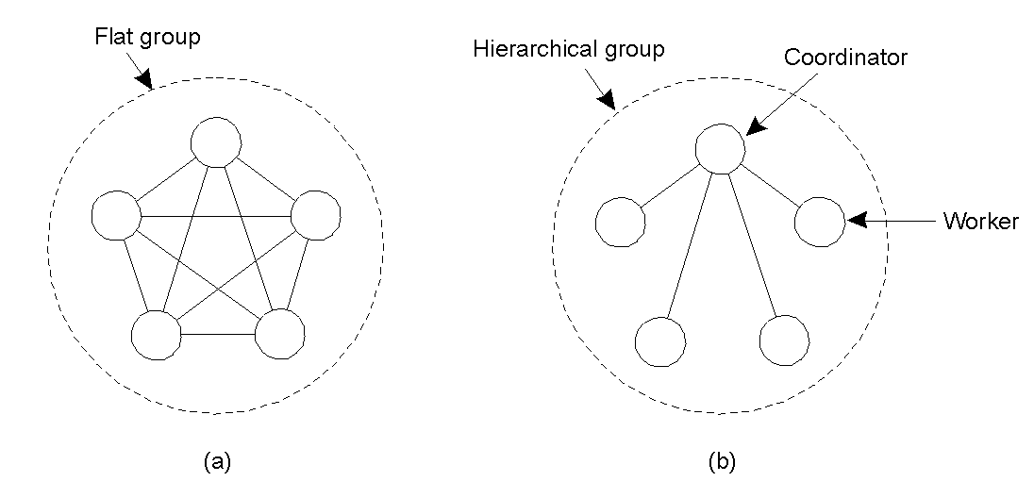
Flat Groups versus Hierarchical Groups
Communication in a flat group.
Communication in a simple hierarchical group
Distributed System (DS)

Slide 34
Fault Tolerance using active replication
E.g. Aircraft (747 have four engines but can fly with three engines)
Sports ( multiple referees in case one misses an event)
Can also referred as State Machine Approach.
Distributed System (DS)

Slide 35
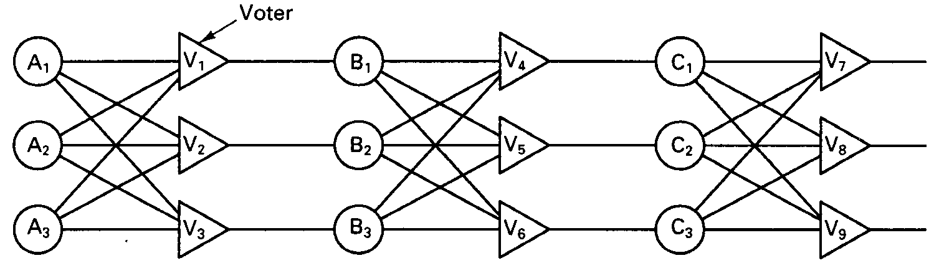
Fault Tolerance using active replication
A
B
C
If one device is faulty then the final result will probably be wrong.
Distributed System (DS)

Slide 36
Each device is replicate three times.
Each stage in the circuit is a triplicated voter.
Each voter is a circuit that has three inputs and one output.
If two or three of the inputs are same, the output is equal to that input.
If all three inputs are different, the output is undefined.
This kind of design is known as TMR(Triple Modular Redundancy)
Suppose element A₂ fails. Each of the voters V₁, V₂ and V₃ gets two good input and one rogue input, and each of them outputs the correct value to the second stage.
The effect of A₂ failing is completed masked, so that the inputs to B₁, B₂ and B₃ are exactly the same as they would have been had no fault occurred.
If B₃ and C₁ are also faulty in addition to A₂, These effects also masked, so the three final outputs are still correct.
Distributed System (DS)

Slide 37
How much replication is needed?
A system is said to be k fault tolerant if it can survive faults in k components and still meet its specifications.
K+1 processors can fault tolerant k fail-stop faults. If k of them fail, the one left can work. But need 2k+1 to tolerate k Byzantine faults because if k processors send out wrong replies, but there are still k+1 processors giving the correct answer. By majority vote, a correct answer can still be obtained.
Distributed System (DS)

Slide 38
Fault tolerance using primary backup
With a primary backup approach, one server (the primary) does all the work.
When the server fails, the backup takes over.
A backup may periodically ping the primary with "are you alive" messages. If it fails to get an acknowledgement, then the backup may assume that the primary failed and it will take over the functions of the primary.
If the system is asynchronous, there are no upper bounds on a timeout value for the pings. This is a problem.
Advantage: relatively easy to design since requests do not have to go multicast to a group of machines and there are no decisions to be made on who takes over.
Disadvantage: another backup is needed immediately.
Backup servers work poorly with Byzantine faults, since the backup may not be able to detect that the primary has actually failed.
Distributed System (DS)

Slide 39
Fault Tolerance using primary backup
1. Request
2. Do work
3. Update
4. Do work
Client
Primary
Backup
6. Reply
5. Ack
A simple primary backup protocol on write operation.
If the primary crashes
Before doing work (step 2):
No harm is done
After doing the work but before sending the update :
work will be done a second time by backup.
After step 4 before step 6:
work may end up being done three times (once by primary, once by the backup as a result of step 3 and once after the backup becomes the primary)
Distributed System (DS)

Slide 40
Recovery from a primary failure may be time-consuming and/or complex depending on the needs for continuous operation and application recovery.
Cold Failover:
  Cold failover entails application restart on the backup machine. When a backup machine takes over, it starts all the applications that were previously running on the primary system. Of course, any work that the primary may have done is now lost.
Warm failover:
  applications periodically write checkpoint files onto stable storage that is shared with the backup system. When the backup system takes over, it reads the checkpoint files to bring the applications to the state of the last checkpoint.
Hot failover:
  applications on the backup run in lockstep synchrony with applications on the primary, taking the same inputs as on the primary. When the backup takes over, it is in the exact state that the primary was in when it failed.
Distributed System (DS)

Slide 41
Handling of Processor Faults
Backward recovery – checkpoints.
In the check pointing method, two undesirable situations can occur:
Lost message
  The state of process P_{i} indicates that it has sent a message m to process P_{j}. P_{j} has no record of receiving this message.
Orphan message
  The state of process P_{j} is such that it has received a message m from the process P_{i} but the state of the process P_{i} is such that it has never sent the message m to P_{j}.
Distributed System (DS)

Slide 42
Checkpoints
A strongly consistent set of checkpoints consist of a set of local checkpoints such that there is no orphan or lost message.
A consistent set of checkpoints consists of a set of local checkpoints such that there is no orphan message.
Synchronous checkpointing:
  A processor P_{i} needs to take a checkpoint only if there is another process P_{j} that has taken a checkpoint that includes the receipt of a message from P_{i} and P_{i} has not recorded the sending of this message.
  In this way no orphan message will be generated.
Asynchronous checkpointing
  Each process takes its checkpoints independently without any coordination.
Hybrid checkpointing
  Synchronous checkpoints are established in a longer period while asynchronous checkpoints are used in a shorter period. That is, within a synchronous period there are several asynchronous periods.
Distributed System (DS)

Slide 43
Agreement
Need agreement in DS:
  Leader, commit, synchronize
Distributed Agreement algorithm: all non-faulty processes achieve consensus in a finite number of steps
  Perfect processes, faulty channels: two-army
  Faulty processes, perfect channels: Byzantine generals
Distributed System (DS)

Slide 44
Agreement in Faulty Systems
Two-army problem
Two blue armies must reach agreement to attack a red army. If one blue army attacks by itself it will be slaughtered. They can only communicate using an unreliable channel: sending a messenger who is subject to capture by the red army.
They can never reach an agreement on attacking.
Now assume the communication is perfect but the processors are not. The classical problem is called the Byzantine generals problem. N generals and M of them are traitors. Can they reach an agreement?
Distributed System (DS)

Slide 45
Two-Army Problem
Distributed System (DS)
Notes:
In this example, Enemy Red Army has 5000 troops. Blue Army has two separate gatherings, Blue (1) and Blue (2), each of 3000 troops. Alone Blue will loose, together as a coordinated attack Blue can win. Communications is by unreliable channel (send a messenger who may be captured by red army so may not arrive.

Slide 46
Two-Army Problem
In this example, Enemy Red Army has 5000 troops. Blue Army has two separate gatherings, Blue (1) and Blue (2), each of 3000 troops. Alone Blue will loose, together as a coordinated attack Blue can win. Communications is by unreliable channel (send a messenger who may be captured by red army so may not arrive.
Distributed System (DS)

Slide 47
Impossible Consensus
Agreement is impossible in asynchronous DS, even if only one process fails [Fischer et al.]
Asynchronous DS:
  messages cannot be guaranteed to be delivered within a known, finite time
  cannot distinguish a slow process from a crashed one
Distributed System (DS)

Slide 48
Possible Consensus
Agreement is possible in synchronous DS [e.g., Lamport et al.]
  Messages can be guaranteed to be delivered within a known, finite time.
  Byzantine Generals Problem
A synchronous DS: can distinguish a slow process from a crashed one
Distributed System (DS)

Slide 49
Lamport’s Algorithm
Step 1: Every non faulty process i sends v_{i} to every other process using reliable unicasting. Faulty process can send anything.
Step 2: The result of the announcements of step 1 are collected together in the form of vectors.
Step 3: Every process passing its vector from to every other process. (process may gets n-1 vectors).
Step 4: Each process examines the ith element of each of the newly received vectors. If any value has a majority, that value is put into the result vector. Of no value has majority, the corresponding element of the result vector is marked UNKNOWN.
Distributed System (DS)

Slide 50
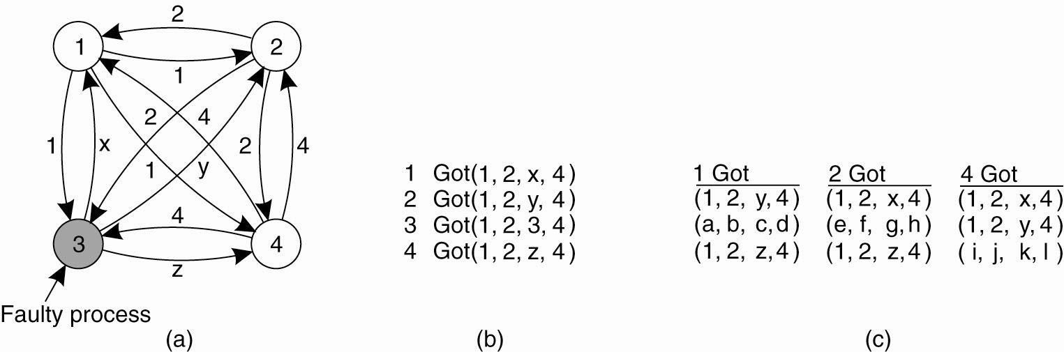
Lamport’s algorithm
N = 4(processor)
M = 1 (traitor)
The Byzantine agreement problem for three
non faulty and one faulty process. (a) Each process sends their value to the others.
(b) The vectors that each process assembles based on (a).
(c) The vectors that each process receives in step 3.
Distributed System (DS)

Slide 51
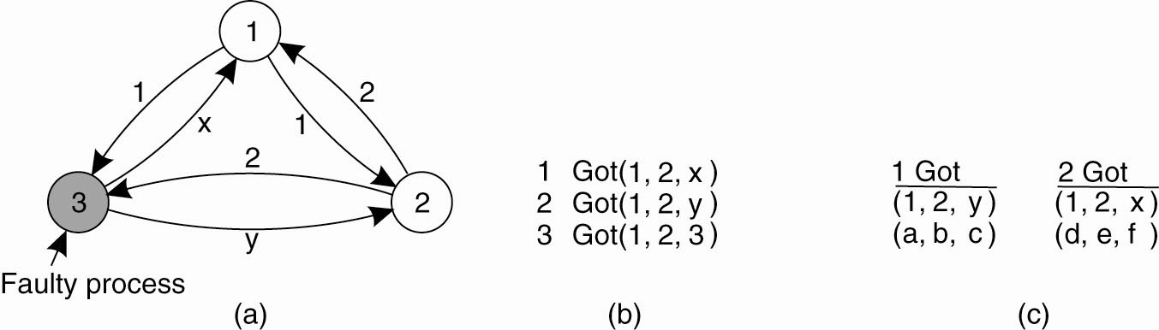
Result
If there are m faulty processors, agreement can be achieved only if 2m+1 correct processors are present, for a total of 3m+1.
Suppose n=3, m=1. Agreement cannot be reached.
With two correct process and one faulty process.
No majority. Cannot reach an agreement.
Distributed System (DS)

Slide 52
Agreement under different models
Turek and Shasha considered the following parameters for the agreement problem.
The system can be synchronous (A=1) or asynchronous (A=0).
Communication delay can be either bounded (B=1) or unbounded (B=0).
Messages can be either ordered (C=1) or unordered (C=0).
The transmission mechanism can be either point-to-point (D=0) or broadcast (D=1).
Distributed System (DS)

Slide 53
A Karnaugh map for the agreement problem
 | 00 | 01 | 11 | 10
00 | 0 | 0 | 1 | 0
01 | 0 | 0 | 1 | 0
11 | 1 | 1 | 1 | 1
10 | 0 | 0 | 1 | 1
CD
AB
Circumstances under which distributed agreement can be reached.
Distributed System (DS)

Slide 54
A Karnaugh map for the agreement problem
Minimizing the Boolean function we have the following expression for the conditions under which consensus is possible:
AB+AC+CD = True
(AB=1): Processors are synchronous and communication delay is bounded.
(AC=1): Processors are synchronous and messages are ordered.
(CD=1): Messages are ordered and the transmission mechanism is broadcast.
Distributed System (DS)

Slide 55
Fault Tolerance
Part I Introduction
Part II Process Resilience
Part III Reliable Communication
Part IV Distributed Commit
Part V Recovery

Slide 56
Reliable Group
Communication
Distributed System (DS)

Slide 57
Reliable Group Communication
When a group is static and processes do not fail
Reliable communication = deliver the message to all group members
  Any order delivery
  Ordered delivery
Distributed System (DS)

Slide 58
Reliable-Multicasting
If the number of processes is small, achieving reliability through multiple reliable point-to-point channels is a simple and often straight forward solution.
A message that is sent to a process group should be delivered to each member of that group.
  What happens if during communication a process joins the group?
  Should that process also receive the message?
  We should also determine what happens if a (sending) process crashes during communication.
Multicasting is considered to be reliable when it can be guaranteed that all non faulty group member receive the message.
If we assume that processes do not fail, and processes do not join or leave the group while communication is going on, reliable multicasting simply means that every message should be delivered to each current group member.
In the simplest case, there is no requirement that all group members receive messages in the same order, but sometimes this feature is needed.
Distributed System (DS)

Slide 59
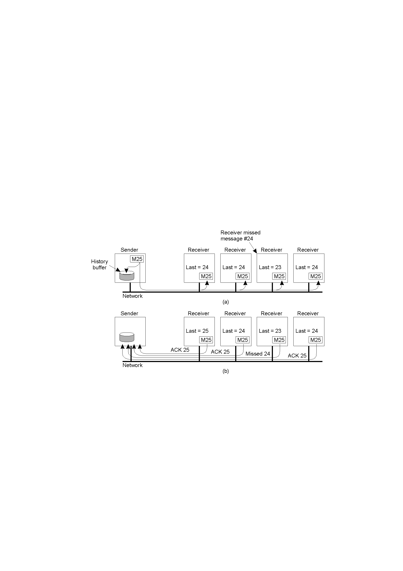
Basic Reliable-Multicasting Schemes
A simple solution to reliable multicasting when all receivers are known and are assumed not to fail
Message transmission
Reporting feedback
Distributed System (DS)

Slide 60
SRM: Scalable Reliable Multicasting
In Reliable Multicast: If there are N receivers, the sender must be prepared to accept at least N acknowledgments (more load on network)
In SRM: Receivers never acknowledge successful delivery.
Only missing messages are reported. (Problem: Sender have to keep a message in its history buffer forever)
NACKs are multicast to all group members.
This allows other members to suppress their feedback, if necessary.
To avoid “retransmission clashes”, each member is required to wait a random delay prior to NACKing.
Distributed System (DS)

Slide 61
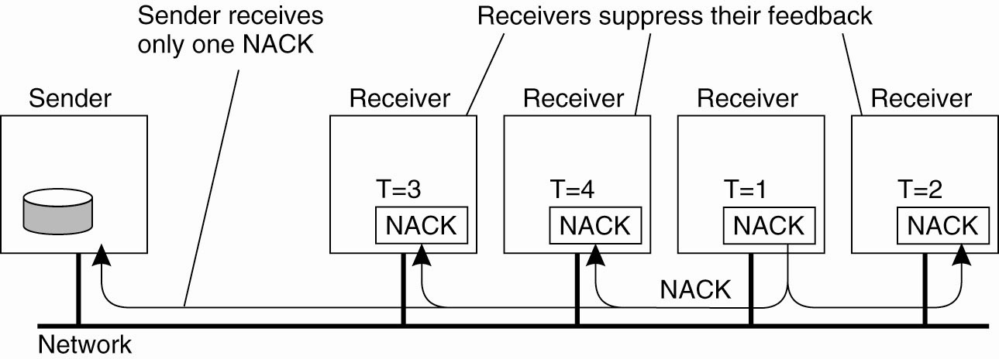
Nonhierarchical Feedback Control
Several receivers have scheduled a request for retransmission, but the first retransmission request leads to the suppression of others
Distributed System (DS)

Slide 62
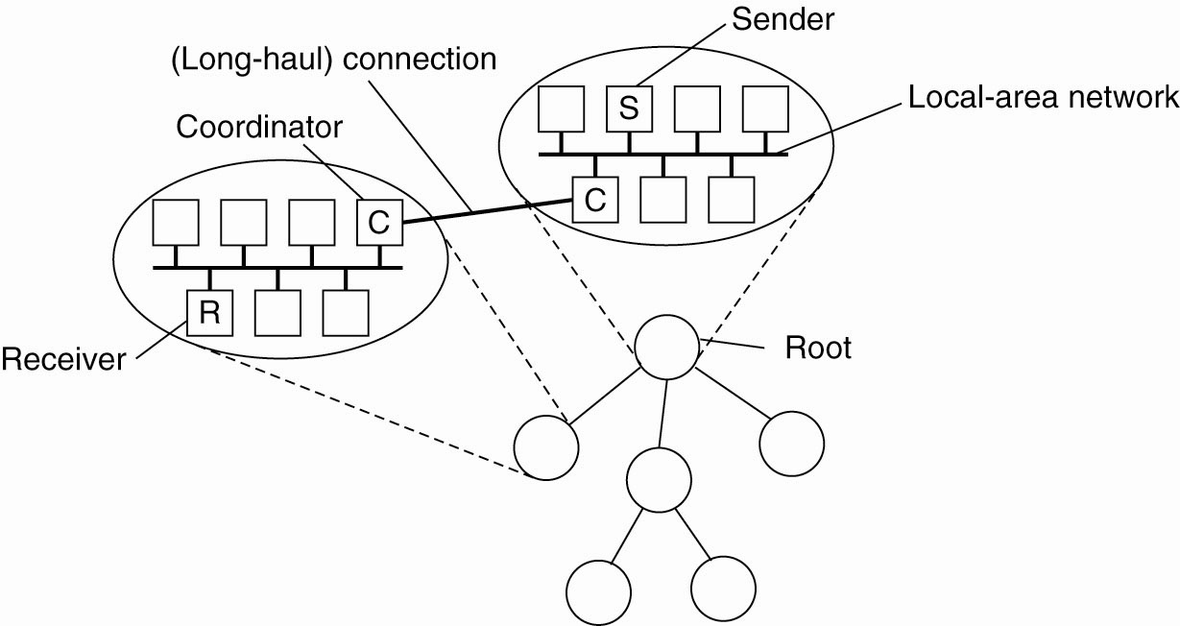
Hierarchical Feedback Control
The essence of hierarchical reliable multicasting.
Each local coordinator forwards the message to its children and later handles retransmission requests.
Each subgroup appoints a local coordinator, which is responsible for handling retransmission requests of receivers contained in its subgroup.
Distributed System (DS)

Slide 63
Hierarchical Feedback Control(2)
The local coordinator will thus have its own history buffer.
If the coordinator itself has missed a message m, it asks the coordinator of the parent subgroup to retransmit m.
In a scheme based on acknowledgments, a local coordinator sends an acknowledgment to its parent if it has received the message.
If a coordinator has received acknowledgments for message m from all members in its subgroup, as well as from its children, it can remove m from its history buffer.
The main problem with hierarchical solutions is the construction of the tree.
Distributed System (DS)

Slide 64
Atomic Multicast
All messages are delivered in the same order to “all” processes
Group view: the view on the set of processes contained in the group
Virtual synchronous multicast: a message m multicast to a group view G is delivered to all non-faulty processes in G
  If sender fails “before” m reaches a non-faulty process, none of the processes deliver m.
If the sender of the message crashes during the multicast, the message may either be delivered to all remaining processes, or ignored by each of them.
A reliable multicast with this property is said to be virtually synchronous
Distributed System (DS)

Slide 65
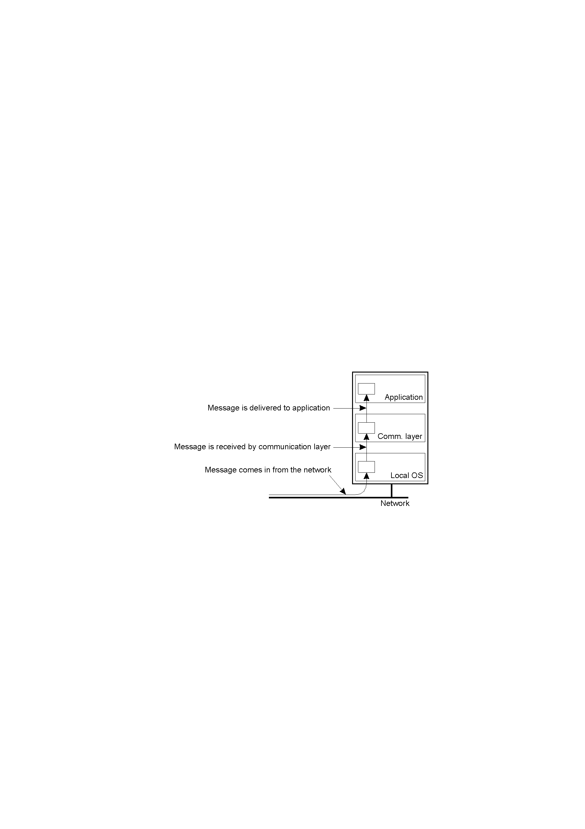
Virtual Synchrony System Model
Fig. The logical organization of a distributed system to distinguish between message receipt and message delivery
A received message is locally buffered in the communication layer until it can be delivered to the application that is logically placed at a higher layer.
Distributed System (DS)

Slide 66
Virtual Synchrony (2)
Assume that while the multicast is taking place, another process joins or leaves the group. (need announcement of change in group membership to all processes in G).
A view change takes place by multicasting a message vc announcing the joining or leaving of a process.
We now have two multicast messages simultaneously in transit: m and vc.
Need to guarantee is that m is either delivered to all processes in G before each one of them is delivered message vc, or m is not delivered at all.
Distributed System (DS)

Slide 67
Question: if m is not delivered to any process, how can we speak of a reliable multicast protocol?
  In principle. there is only one case in which delivery of m is allowed to fail:
    when the group membership change is the result of the sender of m crashing.
    In that case, either all members of G should hear the abort of the new member, or none.
    Alternatively, m may be ignored by each member, which corresponds to the situation that the sender crashed before m was sent.
Distributed System (DS)

Slide 68
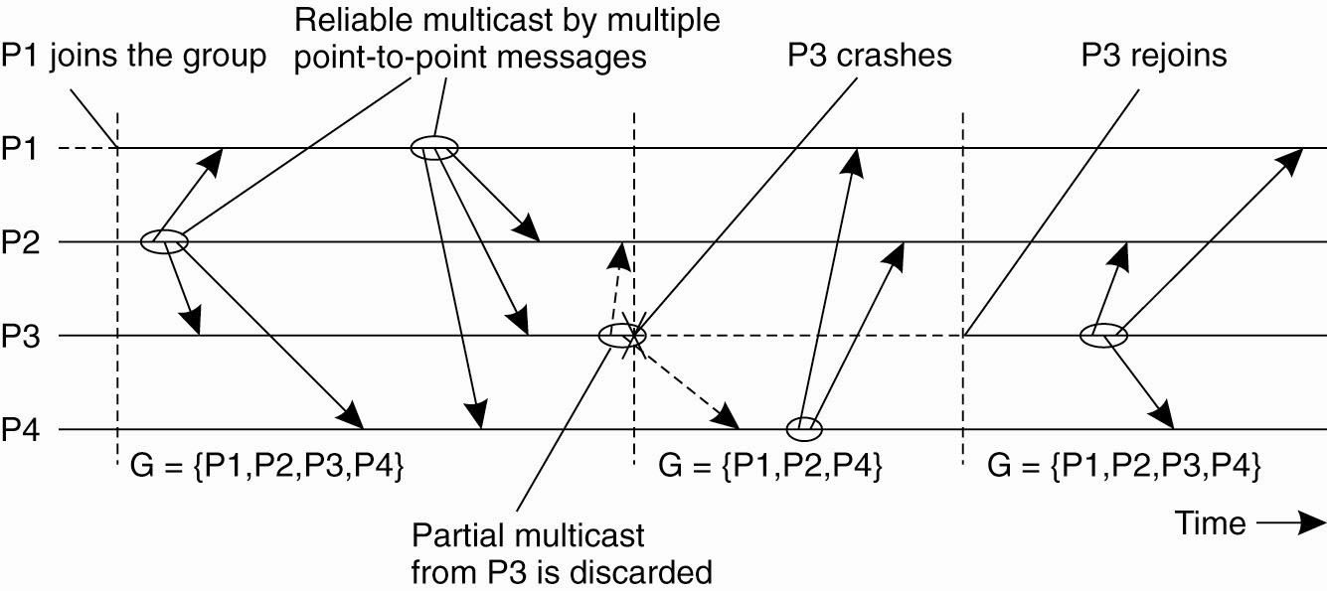
Virtual Synchrony (3)
Fig: The principle of virtual synchronous multicast
After some messages have been multicast, P3 crashes. However, before crashing. it succeeded in multicasting a message to process P2 and P4, but not to P1.
However, virtual synchrony guarantees that the message is not delivered at all, effectively establishing the situation that the message was never sent before P3 crashed.
Distributed System (DS)

Slide 69
Reliability of Group Communication?
A sent message is received by all members
(acks from all => ok)
Problem: during a multicast operation
  an old member disappears from the group
  a new member joins the group
Solution
  membership changes synchronize multicasting
    during a MC operation no membership changes
  Virtual synchrony: “all” processes see message and membership change in the same order
Distributed System (DS)

Slide 70
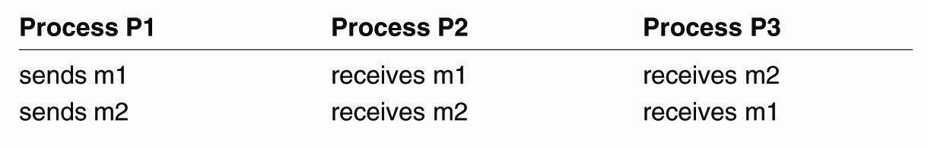
Message Ordering (1)
Four different orderings are distinguished:
Unordered multicasts
FIFO-ordered multicasts
Causally-ordered multicasts
Totally-ordered multicasts
Unordered
Three communicating processes in the same group. The ordering of events per process is shown along the vertical axis.
Distributed System (DS)

Slide 71
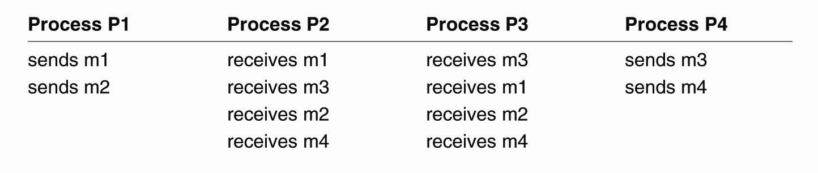
Message Ordering (2)
FIFO
Four processes in the same group with two different senders, and a possible delivery order of messages under FIFO-ordered multicasting
Distributed System (DS)

Slide 72
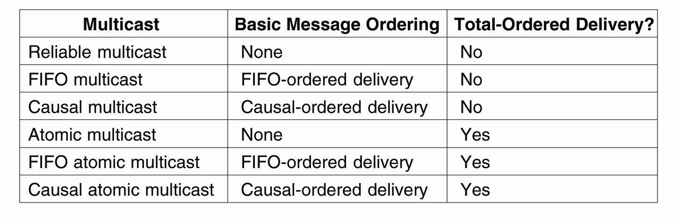
Implementing Virtual Synchrony (1)
Six different versions of virtually
synchronous reliable multicasting
Distributed System (DS)

Slide 73
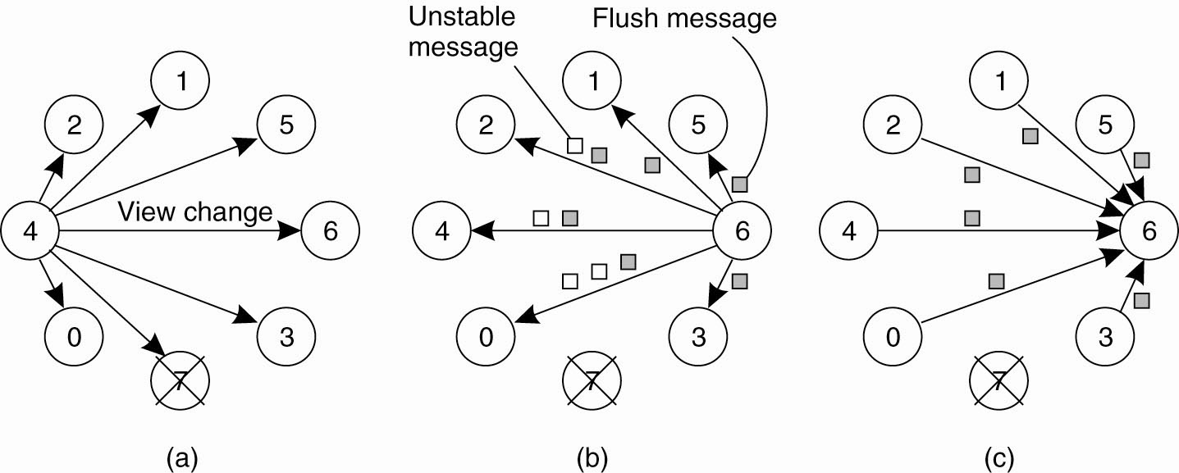
Implementing Virtual Synchrony (2)
Process 4 notices that process 7 has crashed and sends a
view change
(b) Process 6 sends out all its unstable messages, followed by
a flush message
Distributed System (DS)

Slide 74
Implementing Virtual Synchrony (3)
(c) Process 6 installs the new view when it has received a flush message from everyone else
Distributed System (DS)

Slide 75
Fault Tolerance
Part I Introduction
Part II Process Resilience
Part III Reliable Communication
Part IV Distributed Commit
Part V Recovery

Slide 76
Distributed Commit
Goal: Either all members of a group decide to perform an operation, or none of them perform the operation
Atomic transaction: a transaction that happens completely or not at all
Is required in distributed transactions
Distributed System (DS)

Slide 77
Assumptions
Failures:
  Crash failures that can be recovered
  Communication failures detectable by timeouts
Notes:
  Commit requires a set of processes to agree…
  …similar to the Byzantine generals problem…
  … but the solution much simpler because stronger assumptions
Distributed System (DS)

Slide 78
Distributed Transactions
client
ser-ver
Database
atomic
ser-ver
Atomic
Consistent
Isolated
Durable
isolated
serializable
ser-ver
Database
client
Distributed System (DS)

Slide 79
A Distributed Banking Transaction
openTransaction
join
participant
closeTransaction
.
A
a.withdraw(4);
.
join
BranchX
T
participant
Client
B
b.withdraw(3);
T =
openTransaction
BranchY
a.withdraw(4);
join
c.deposit(4);
participant
b.withdraw(3);
d.deposit(3);
C
c.deposit(4);
closeTransaction
D
d.deposit(3);
BranchZ
Distributed System (DS)

Slide 80
Distributed commit
Is done by using atomic commitment protocols (ACP)
  One-phase Commit
  Two-phase Commit
  Three-phaseCommit
Distributed System (DS)

Slide 81
One-phase Commit
One-phase commit protocol
    This scheme however is not fault tolerant
  One site is designated as a coordinator
  The coordinator tells all the other processes whether or not to locally perform the operation in question
  But, what if a process cannot perform the operation? There’s no way to tell the coordinator!
  The solutions:
  The Two-Phase and Three-Phase Commit Protocols.
Distributed System (DS)

Slide 82
Two Phase Commit (2PC)
Coordinator
Participants
send VOTE_REQ to all
send vote to coordinator
if (vote == no)
decide abort
halt
if (all votes yes)
decide commit
send COMMIT to all
else
decide abort
send ABORT to all who voted yes
halt
if receive ABORT, decide abort
else decide commit
halt
Distributed System (DS)

Slide 83
Two-Phase Commit
One site is elected coordinator of the transaction T (See Election algorithms)
Phase 1: When coordinator is ready to commit the transaction
    Place Prepare(T) state in log on stable storage
    Send Vote_request(T) message to all other participants
    Wait for replies
Phase 2: Coordinator
  If any participant replies Abort(T)
    Place Abort(T) state in log on stable storage
    Send Global_Abort(T) message to all participants
    Locally abort transaction T
  If all participants reply Ready_to_commit(T)
    Place Commit(T) state in log on stable storage
    Send Global_Commit(T) message to all participants
    Proceed to commit transaction locally
Distributed System (DS)

Slide 84
Two-Phase Commit (continued)
Phase I: Participant gets Vote_request(T) from coordinator
    Place Abort(T) or Ready(T) state in local log
    Reply with Abort(T) or Ready_to_commit(T) message to coordinator
    If Abort(T) state, locally abort transaction
Phase II: Participant
    Wait for Global_Abort(T) or Global_Commit(T) message from coordinator
    Place Abort(T) or Commit(T) state in local log
    Abort or commit locally per message
Distributed System (DS)

Slide 85
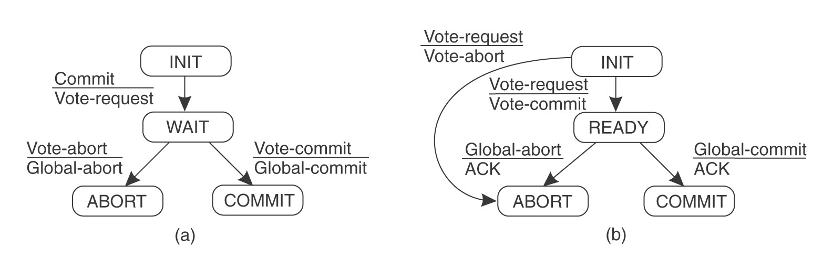
Two-Phase Commit States
PREPARE
coordinator participant
Distributed System (DS)

Slide 86
Big Problem with Two-Phase Commit
It can lead to both the coordinator and the group members blocking, which may lead to the dreaded deadlock.
If the coordinator crashes, the group members may not be able to reach a final decision, and they may, therefore, block until the coordinator recovers …
Two-Phase Commit is known as a blocking-commit protocol for this reason.
The solution? The Three-Phase Commit Protocol.
Distributed System (DS)

Slide 87
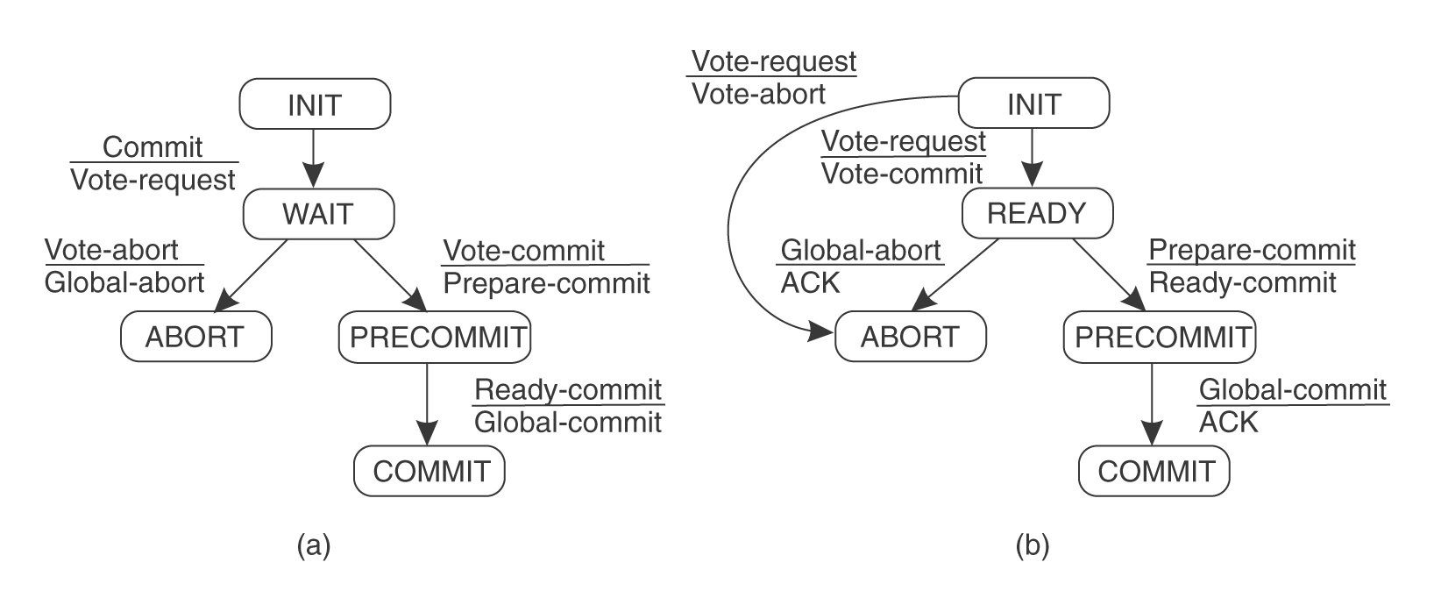
Three-Phase Commit (1)
There is no state from which a transition can be made to either Commit or Abort
There is no state where it is not possible to make a final decision and from which transition can be made to Commit
⇒ non-blocking commit protocol
Distributed System (DS)

Slide 88
Three-Phase Commit
Coordinator:
  Phase 1: The coordinator receives a transaction request. If there is a failure at this point, the coordinator aborts the transaction (i.e. upon recovery, it will consider the transaction aborted). Otherwise, the coordinator sends a canCommit? message to the participants and moves to the waiting state.
  Phase 2: If there is a failure, timeout, or if the coordinator receives a No message in the waiting state, the coordinator aborts the transaction and sends an abort message to all participants. Otherwise the coordinator will receive Yes messages from all participants within the time window, so it sends preCommit messages to all participants and moves to the prepared state.
  Phase 3: If the coordinator succeeds in the prepared state, it will move to the commit state. However if the coordinator times out while waiting for an acknowledgement from a participant, it will abort the transaction. In the case where all acknowledgements are received, the coordinator moves to the commit state as well.
Distributed System (DS)

Slide 89
Three-Phase Commit
Participants
  Phase 1: The participant receives a canCommit? message from the coordinator. If the participant agrees it sends a Yes message to the coordinator and moves to the prepared state. Otherwise it sends a No message and aborts. If there is a failure, it moves to the abort state.
  Phase 2: In the prepared state, if the participant receives an abort message from the coordinator, fails, or times out waiting for a commit, it aborts. If the participant receives a preCommit message, it sends an ACK message back and awaits a final commit or abort.
  Phase 3: If, after a participant member receives a preCommit message, the coordinator fails or times out, the participant member goes forward with the commit.
Distributed System (DS)

Slide 90
Three-Phase Commit (continued)
Coordinator sends Vote_Request (as before)
If all participants respond affirmatively,
    Put Precommit state into log on stable storage
    Send out Prepare_to_Commit message to all
After all participants acknowledge,
    Put Commit state in log
    Send out Global_Commit
Distributed System (DS)

Slide 91
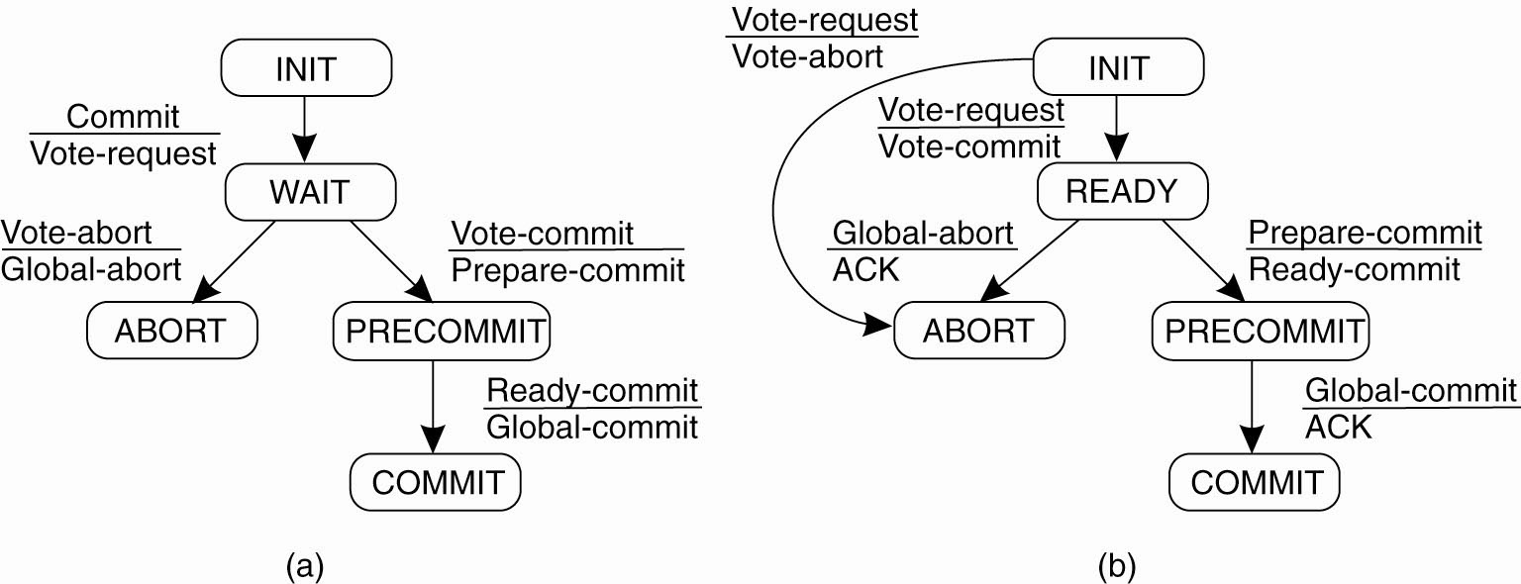
Three-Phase Commit …
Figure (a) The finite state machine for the coordinator in 3PC. (b) The finite state machine for a participant.
Distributed System (DS)

Slide 92
Fault Tolerance
Part I Introduction
Part II Process Resilience
Part III Reliable Communication
Part IV Distributed Commit
Part V Recovery

Slide 93
Recovery
Once a failure has occurred, it is essential that the process where the failure happened recovers to a correct state.
Recovery from an error is fundamental to fault tolerance.
Two main forms of recovery:
  Backward Recovery: return the system to some previous correct state (using checkpoints), then continue executing.
    Examples
      Reliable communication through packet retransmission
  Forward Recovery: bring the system into a correct state, from which it can then continue to execute.
    Examples:
      Reliable communication via erasure correction, such as an (n, k) block erasure code

Slide 94
Forward and Backward Recovery
Major disadvantage of Backward Recovery:
  Checkpointing can be very expensive (especially when errors are very rare).
  [Despite the cost, backward recovery is implemented more often. The “logging” of information can be thought of as a type of checkpointing.].
Major disadvantage of Forward Recovery:
  In order to work, all potential errors need to be accounted for up-front.
  When an error occurs, the recovery mechanism then knows what to do to bring the system forward to a correct state.

Slide 95
Stable Storage
In order to store checkpoints and logs, information needs to be stored safely - not just able to survive crashes, but also able to survive hardware faults
RAID (of the mirroring or parity checking variety) is the typical example of stable storage

Slide 96
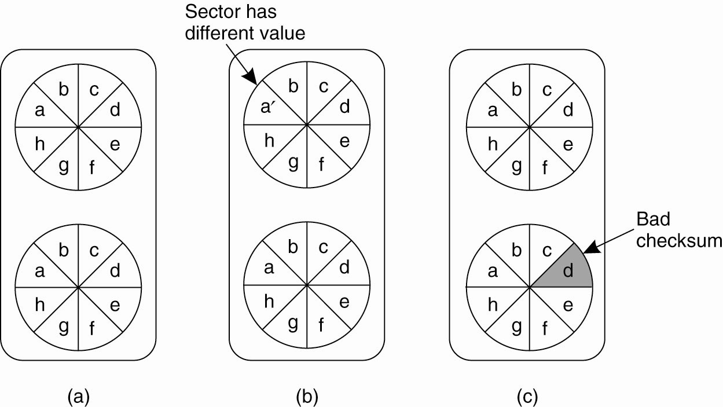
Recovery – Stable Storage
Figure 8-23. (a) Stable storage.
(b) Crash after drive 1 is updated. (c) Bad spot.

Slide 97
Checkpointing
Related to checkpointing, let us first discuss the global state and the distributed snapshot algorithm

Slide 98
Determining Global States
The Global State of a distributed computation is
  the set of local states of all individual processes involved in the computation
  +
  the states of the communication channels
How?

Slide 99
Obvious First Solution…
Synchronize clocks of all processes and ask all processes to record their states at known time t
Problems?
  Time synchronization possible only approximately
    distributed banking applications: no approximations!
  Does not record the state of messages in the channels

Slide 100
Global State
We cannot determine the exact global state of the system, but we can record a snapshot of it
Distributed Snapshot: a state the system might have been in [Chandy and Lamport]

Slide 101
A naïve snapshot algorithm
Processes record their state at any arbitrary point
A designated process collects these states
+ So simple!!

Slide 102
The “Snapshot” Algorithm
Records a set of process and channel states such that the combination is a consistent GS.
Assumptions:
  No failure, all messages arrive intact, exactly once
  Communication channels are unidirectional and FIFO-ordered
  There is a comm. path between any two processes
  Any process may initiate the snapshot (sends Marker)
  Snapshot does not interfere with normal execution
  Each process records its state and the state of its incoming channels

Slide 103
The “Snapshot” Algorithm (2)
1. Marker sending rule for initiator process P₀
  After P₀ has recorded its state
    for each outgoing channel C, sends a marker on C
2. Marker receiving rule for a process P_{k,} on receipt of a marker over channel C
  if P_{k} has not yet recorded its state
    records P_{k}’s state
    records the state of C as “empty”
    turns on recording of messages over other incoming channels
    for each outgoing channel C, sends a marker on C
  else
    records the state of C as all the messages received over C since P_{k} saved its state

Slide 104
Snapshot Example
e₁⁰
e₁^{1,2}
e₁³
e₁⁴
P1
M
M
a
M
e₂⁴
e₂⁵
M
P2
e₂⁰
e₂^{1,2,3}
M
M
b
P3
e₃⁰
e₃^{1,2,3}
e₃⁴
1- P1 initiates snapshot: records its state (S1); sends Markers to P2 & P3; turns on recording for channels C21 and C31
2- P2 receives Marker over C12, records its state (S2), sets state(C12) = {} sends Marker to P1 & P3; turns on recording for channel C32
3- P1 receives Marker over C21, sets state(C21) = {a}
4- P3 receives Marker over C13, records its state (S3), sets state(C13) = {} sends Marker to P1 & P2; turns on recording for channel C23
5- P2 receives Marker over C32, sets state(C32) = {b}
6- P3 receives Marker over C23, sets state(C23) = {}

Slide 105
Snapshot Example
e₁⁰
e₁³
P1
a
e₂⁴
P2
e₂⁰
b
P3
e₃⁰

Slide 106
Distributed Snapshot Algorithm
When a process finishes local snapshot, it collects its local state (S and C) and sends it to the initiator of the distributed snapshot
The initiator can then analyze the state
One algorithm for distributed global snapshots, but it’s not particularly efficient for large systems

Slide 107
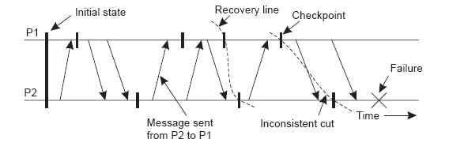
Checkpointing
The most recent distributed snapshot in a system is also called the recovery line

Slide 108
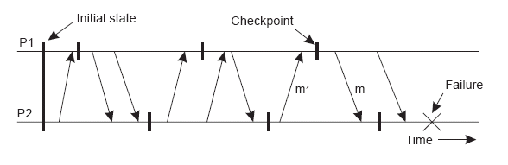
Independent Checkpointing
It is often difficult to find a recovery line in a system where every process just records its local state every so often - a domino effect or cascading rollback can result:

Slide 109
Coordinated Checkpointing
To solve this problem, systems can implement coordinated checkpointing
We’ve discussed one algorithm for distributed global snapshots, but it’s not particularly efficient for large systems
Another way to do it is to use a two-phase blocking protocol (with some coordinator) to get every process to checkpoint its local state “simultaneously”

Slide 110
Coordinated Checkpointing
Make sure that processes are synchronized when doing the checkpoint
Two-phase blocking protocol
  Coordinator multicasts CHECKPOINT_REQUEST
  Processes take local checkpoint
  Delay further sends
  Acknowledge to coordinator
  Send state
  Coordinator multicasts CHECKPOINT_DONE

Slide 111
Message Logging
Check pointing is expensive - message logging allows the occurrences between checkpoints to be replayed, so that checkpoints don’t need to happen as frequently
We need to choose when to log messages
Message-logging schemes can be characterized as pessimistic or optimistic by how they deal with orphan processes
  An orphan process is one that survives the crash of another process but has an inconsistent state after the other process recovers

Slide 112
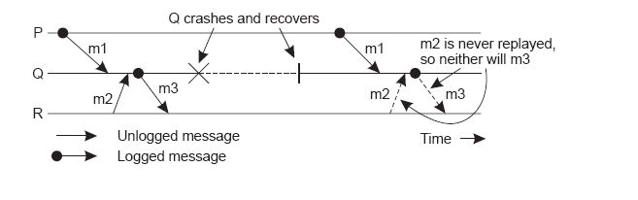
Message Logging
An example of an incorrect replay of messages
We assume that each message m has a header containing all the information necessary to retransmit m (sender, receiver, sequence no., etc.)

Slide 113
Summary (1 of 2)
Fault Tolerance:
  The characteristic by which a system can mask the occurrence and recovery from failures. A system is fault tolerant if it can continue to operate even in the presence of failures.
Types of failure:
  Crash (system halts);
  Omission (incoming request ignored);
  Timing (responding too soon or too late);
  Response (getting the order wrong);
  Arbitrary/Byzantine (indeterminate, unpredictable).

Slide 114
Summary (2 of 2)
Fault Tolerance is generally achieved through use of redundancy and reliable multitasking protocols.
Processes, client/server and group communications can all be “enhanced” to tolerate faults in a distributed system. Commit protocols allow for fault tolerant multicasting (with two-phase the most popular type).
Recovery from errors within a Distributed System tends to rely heavily on Backward Recovery techniques that employ some type of checkpointing or logging mechanism, although Forward Recovery is also possible.

